Slide 1

A Presentation on “EFFICIENT AUTOMATED DISEASE DIAGNOSIS” By Apurv Panbude(C220) Prashant Pandey (C221) Yash Agarwal (C245) Under the Guidance of Prof. Pankaj Gulhane
Department of Electronics and Telecommunication Engineering
MPSTME, Shirpur Campus
2021-22

Slide 2
OUTLINE
Objective of Project
Literature Survey
Problem Statement
Proposed Solution
Dataset
Methodology
Result Analysis/Implementation
Conclusion
Future Work
References

Slide 3
OBJECTIVE
Disease prediction is based on the information provided by the user.​
To provide the accurate result based on the user input.​
Diagnosis of whether the user is suffering from a particular disease or not.​
If the user is suffering from the disease, to provide them with advise to visit a doctor and have a proper checkup to avoid severity of hazardous disease.

Slide 4
LITERATURE SURVEY
Author​ Name​ | Title​ | Year of Publication​ | Disease​ | Methodology​ | Performance​
Naresh Kumar, Nripendra Narayan Das, Deepali Gupta | Efficient Automated Disease Diagnosis Using Machine Learning Models | 2021 | COVID, Heart Disease, Diabetes | Logistic Regression | 84.4%, 88.5%, 87.8%
Jian Ping LI, Amin Ul Haq, Salah Ud Din | Heart Disease Identification Method Using Machine Learning Classification in E-Healthcare | 2020 | Heart Disease | Support vector machine, Logistic regression, Artificial neural network, K-nearest neighbor, Naïve bays, and Decision tree | 92.4%

Slide 5
LITERATURE SURVEY (CONTD.)
Author​ Name​ | Title​ | Year of Publication​ | Disease​ | Methodology​ | Performance​
Md. Kamrul Hasan, Dola Das​ | Diabetes Prediction Using Ensembling of Different Machine Learning Classifiers​ ​ | 2020​ | Diabetes​ | Naïve Bayes, AdaBoost, Random Forest, K-Nearest Neighbour, XGBoost​ | 83.2% accuracy obtained from Random Forest algorithm​
Chieh-Chen Wu,​ Wen-Chun Yeh​ | Prediction of fatty liver disease using machine learning algorithms​ ​ | 2019​ | Liver​ | Random Forest, Naïve Bayes, Logistic Regression & Artificial Neural Newtwork​ | RF with max ​ accuracy with​ 87.48%.​

Slide 6
LITERATURE SURVEY (CONTD.)
Author​ Name​ | Title​ | Year of Publication​ | Disease​ | Methodology​ | Performance​
Senthikumar Mohan, Gautam Shrivastava​ | Effective Heart Disease Prediction Using Hybrid Machine Learning Techniques​ ​ | 2019​ | Heart​ | K-Nearest Neighbour, Naïve Bayes, Random Forest, Hybrid Random Forest with a linear model​ | HRFLM has max accuracy of 88.7%​
Mogana Darshini Ganggayah, Nur Aishah Taib​ ​ | Predicting factors for survival of breast cancer patients using machine learning techniques​ ​ | 2019​ | Cancer​ | Decision Tree, Random Forest, Neural Network, Extreme Boost, Logistic Regression, Support Vector Machine​ | Highest accuracy of 82.7% obtained from random forest​
Lin Chen,​ Yuhua Liu | A Machine Learning Methodology for Diagnosing Chronic Kidney Disease​ ​ ​ ​ | 2019​ | Kidney​ | Random Forest, Support Vector Machine, K-Nearest Neighbor, Logistic Regression, Naïve Bayes​ ​ | RF algorithm has the maximum accuracy of 88.38%​

Slide 7
PROBLEM STATEMENT
In healthcare informatics, disease prediction is critical. ​
The importance of diagnosing the illness at an early stage cannot be overstated. ​
The current system covers general diseases that occur more frequently such as Breast Cancer, Heart Disease, Liver Disease, Kidney Disease and Diabetes.​
The current system uses the input provided by the user and the dataset that are available in the machine to predict the disease.​

Slide 8
PROPOSED SOLUTION
The purpose of this project is to predict the accurate disease of a patient using all their general information.​
Using this information, we will compare with our previous dataset of the patients.​
Predict the disease he/she has been through.​
If the prediction is done at the early stage of the disease with the help of this project.​
And adequate steps are taken for curing the disease, then this prediction system can be very useful to the health industry.​

Slide 9
DATASET
Breast Cancer Wisconsin (Diagnostic) Data Set
Number of Attributes : 32
Number of Instances : 569
Dependent Attribute : Diagnosis (M/B)

Slide 10
DATASET (CONTD.)
Ten real-valued features are computed for each cell nucleus:
radius (mean of distances from center to points on the perimeter)
texture (standard deviation of gray-scale values)
Perimeter
Area
smoothness (local variation in radius lengths)
compactness (perimeter^2 / area - 1.0)
concavity (severity of concave portions of the contour)
concave points (number of concave portions of the contour)
Symmetry
fractal dimension ("coastline approximation" - 1)

Slide 11
DATASET (CONTD.)
Indian Liver Patient Records
Number of Attributes: 11
Number of Instances: 583
Dependent Attribute: Dataset (1/2)

Slide 12
DATASET (CONTD.)
Features:-
Age of the patient
Gender of the patient
Total Bilirubin
Direct Bilirubin
Alkaline Phosphatase
Alamine Aminotransferase
Aspartate Aminotransferase
Total Proteins
Albumin
Albumin and Globulin Ratio

Slide 13
DATASET (CONTD.)
Heart Disease Dataset
Number of Attributes: 14
Number of Instances: 303
Dependent Attribute: target (0/1)

Slide 14
DATASET (CONTD.)
Features:-
age
sex
chest pain type (4 values)
resting blood pressure
serum cholestoral in mg/dl
fasting blood sugar > 120 mg/dl
resting electrocardiographic results (values 0,1,2)
maximum heart rate achieved
exercise induced angina
oldpeak = ST depression induced by exercise relative to rest
the slope of the peak exercise ST segment
number of major vessels (0-3) colored by flourosopy
thal: 0 = normal; 1 = fixed defect; 2 = reversable defect

Slide 15
DATASET (CONTD.)
Chronic Kidney Disease Dataset
Number of Attributes: 26
Number of Instances: 400
Dependent Attribute: classification (0/1)

Slide 16
DATASET (CONTD.)
age - age
bp - blood pressure
sg - specific gravity
al - albumin
su - sugar
rbc - red blood cells
pc - pus cell
pcc - pus cell clumps
ba - bacteria
bgr - blood glucose random
bu - blood urea
sc - serum creatinine
sod - sodium
pot - potassium
hemo - hemoglobin
pcv - packed cell volume
wc - white blood cell count
rc - red blood cell count
htn - hypertension
dm - diabetes mellitus
cad - coronary artery disease
appet - appetite
pe - pedal edema
ane - anemia
class - class

Slide 17
DATASET (CONTD.)
Pima Indians Diabetes Database
Number of Attributes: 9
Number of Instances: 768
Dependent Attribute: Outcome (0/1)

Slide 18
DATASET (CONTD.)
Features:-
Pregnancies
Glucose
Blood Pressure
Skin Thickness
Insulin
BMI
Diabetes Pedigree Function
Age

Slide 19
METHODOLOGY
Random Forest Classifier
Random forest is a Supervised Machine Learning Algorithm that is used widely in Classification and Regression problems.
It builds decision trees on different samples and takes their majority vote for classification and average in case of regression.

Slide 20
METHODOLOGY (CONTD.)
Hyperparameters
Hyperparameters are used in random forests to either enhance the performance and predictive power of models or to make the model faster.
Hyperparameters increases the predictive power:
n_estimators
max_features
mini_sample_leaf
Hyperparameters increases the speed:
n_jobs
random_state
oob_score

Slide 21
METHODOLOGY (CONTD.)
Advantages of using RF:
Solves the problem of overfitting as output is based on majority voting or averaging.
Performs well even if the data contains null/missing values.
Highly stable as the average answers given by a large number of trees are taken.

Slide 22
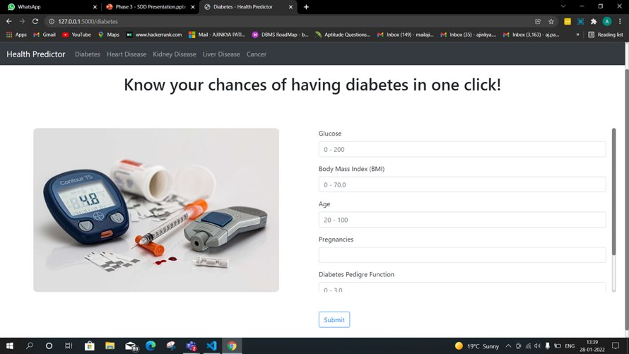
IMPLEMENTATION

Slide 23

IMPLEMENTATION (CONTD.)

Slide 24

IMPLEMENTATION (CONTD.)

Slide 25
RESULT ANALYSIS
Disease | Accuracy
Cancer | 95.6%
Liver Disease | 73.6%
Heart Disease | 71.4%
Kidney Disease | 94.6%
Diabetes | 74.2%

Slide 26
CONCLUSION
Our product will accurately detect whether the patient has disease or not. ​
We are considering the accuracy to be good for prediction if it is in the range of 70 – 95%.​
Product should be able to handle different errors. It should make sure that it is not giving the wrong results.​
The product should be available at any time so that users can assess according to their need.​
It can be used over different locations at any particular time.​
The product will do a real time disease detection.

Slide 27
FUTURE WORKS
More interactive user interface​
Facility for modifying user data​
Provide contact info and take precautionary measures​.
User login system for authentication.
Integration of COVID API​
Testing ​
Deploy webapp on cloud server.​

Slide 28
REFERENCES
Naresh Kumar, Nripendra Narayan Das, Deepali Gupta, Kamali Gupta and Jatin Bindra “Efficient Automated Disease Diagnosis Using Machine Learning Models (2021).”
Jian Ping LI, Amin Ul Haq, Salah Ud Din, Asif Khan “Heart Disease Identification Method Using Machine Learning Classification in E-Healthcare (2020).”
Md. Kamrul Hasan, Md. Ashraful Alam, Dola Das, Eklas Hossain, Mahmudul Hasan “Diabetes Prediction Using Ensembling of Different Machine Learning Classifiers (2020).”
Jiomgming Qin, Lin Chen, Yuhua Liu “A Macine Learning Methodology for Diagnosing Chronic Kidney Diseases (2019).”

Slide 29
REFERENCES (CONTD.)
Senthikumar Mohan, Gautam Shrivastava and Chandrasegar Thirumalai​ “Effective Heart Disease Prediction Using Hybrid Machine Learning Techniques (2019)”
Chieh-ChenWu, Wen-ChunYeh, Wen-DingHsu “Prediction of fatty liver disease using machine learning algorithms.” Taipei Medical University, Taipei (2019).
Senthilkumar Mohan, Chandrasegar Thirumalai, Gautam Srivastava “Effective Heart Disease Prediction Using Hybrid Machine Learning Techniques (2019).”

